Slide 1
ECII/ECSI 3206: Artificial Intelligence [and expert systems] Topic 4: Logic and Truth Tables
By: Edgar Otieno

Slide 2
Introduction to Logic
Problem solving could be broadly subdivided into either Search based techniques or Knowledge based techniques
Knowledge based techniques can be further subdivided into either knowledge representation or Knowledge manipulation.
The schemes for knowledge representations may be either use of Logic statements or use of Semantic networks.

Slide 3
Problem Solving approaches
problem solving
search based techniques
knowledge manipulation

Slide 4
1.Introduction to Logic/Logic statements
Logic-It’s a truth perceiving system of inference.
Proposition-defines a statement that evaluates to either true or false but not both .
Propositional Logic-Defines rules of mathematical logic used to specify methods of reasoning.
Which one is a proposition and which is not out of the statements below?
This is AI class
Today is Monday
B.Tech CN students are doing AI course
A is less than 14

Slide 5
Connectors and logic operators
AND/CONJUNCTION [∧]
OR/DISJUNCTION[V]
EXCLUSIVE DISJUCTION/EXCLUSIVE OR [⊕] or [⊻]
NOT/NEGATION[¬] or [ ˜ ] or [ ! ]
IMPLICATION/CONDITIONAL IMPLICATION[→]
BICONDITIONAL IMPLICATION[↔]

Slide 6
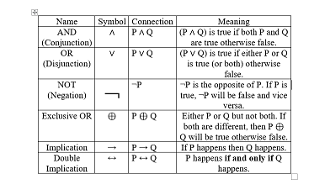
Propositional logic connectives Meaning summary

Slide 7
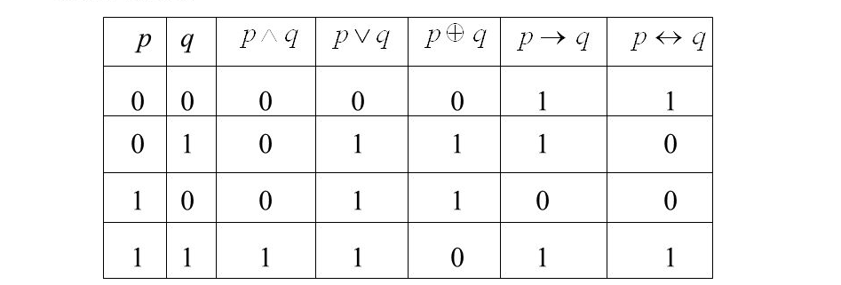
Truth tables
Truth tables-are diagrams used to show every possible truth value.

Slide 8
Truth tables terminologies.
Compound truth tables-These are those truth tables that use multiple connectors e.g ((P V Q) ∧R)
Tautology- It is a compound proposition that always evaluates to TRUE e.g ((P V ¬P)
Contradiction-It is a compound proposition that always evaluates to FALSE e.g ((P ∧ ¬P)
Contingency-any proposition that is neither a Contradiction or a Tautology

Slide 9
P | Q | R | P V Q | (P V Q) ∧R | ¬P | P ∧ ¬P
0 | 0 | 0 | 0 | 0 | 1 | 0
0 | 0 | 1 | 0 | 0 | 1 | 0
0 | 1 | 0 | 1 | 0 | 1 | 0
0 | 1 | 1 | 1 | 1 | 1 | 0
1 | 0 | 0 | 1 | 0 | 0 | 0
1 | 0 | 1 | 1 | 1 | 0 | 0
1 | 1 | 0 | 1 | 0 | 0 | 0
1 | 1 | 1 | 1 | 1 | 0 | 0

Slide 10
Cont..
Well formed formulae-This is an sentense/expression that is constructed correctly according to the rules of propositional calculus
Logical equivalence-two compound propositions are said to be logical equivalent iff P ↔Q is a tautology[always evaluates to TRUE]
e.g ¬(P ∧ Q) ≡ (¬ P V ¬ Q)
¬(P V Q) ≡ (¬ P ∧ ¬ Q)
[The above two statements are Defined as De’morgans Laws]

Slide 11
P | Q | P ∧ Q | ¬(P ∧ Q) | ¬ P | ¬ Q | ¬ P V ¬ Q
0 | 0 | 0 | 1 | 1 | 1 | 1
0 | 1 | 0 | 1 | 1 | 0 | 1
1 | 0 | 0 | 1 | 0 | 1 | 1
1 | 1 | 1 | 0 | 0 | 0 | 0

Slide 12
English statements and their equivalent propositional representation
It is raining in Nairobi: R(N)//RAINING(NAIROBI)
It is raining in Nairobi and I’m either sick or very tired: R(N) ∧(S(I)VT(I))
It is Not Raining in Nairobi:¬R(N)
If it is Raining in Nairobi then I will get wet: R(N) →W(I)

Slide 13
Predicate Logic/Predicate Calculus
Some statements cannot be represented using propositional logic e.g X>3, all men die..etc
Predicate logic-It is an expression of one or more Variables defined within some specific domain.

Slide 14
Structure of Predicate statements
Consider the statement P(X,Y)
P is he predicate describing the relationship
X and Y are Variables/arguments that the relationship P applies upon
e.g.
Likes(edgar,chapati)
Father(sonko,saumu)
Mother(X,Y):-son(Y,X) V daughter(Y,X) ∧ female(X)
Father(X,Y):-son(Y,X) V daughter(Y,X) ∧ male(X)

Slide 15
Quantifiers used in Predicate Logic
These are symbols used to express the extent to which a predicate is True over a set of elements.
They include:-
Universal/for all: ∀
Existential/for some: ∃

Slide 16
Predicate Logic examples
Everyone likes Chapati: ∀(x) P(x) → L(x,c)
There exists a person that likes Chapati : ∃(x) L(x,c)
For everyone, there exist a Y where X loves Y: ∀(x) ∃(y) L(x,y)
Some persons in our class have visited Mombasa: ∃(x)(C(x) ∧M(x))
No one in our class is a musician? ¬∀(x) (Class(x) ∧Musician(x))

Slide 17
Using De’morgan rules to evaluate statements
Consider the expression for : Not everyone likes Chapati.
¬∀(x) (P(x) → L(x,c))
Using De’morgan rules, we can rewrite the statement as follows to eliminate implication symbol[→].
De’morgan rules:
¬(P ∧ Q) ≡ (¬ P V ¬ Q)
¬(P V Q) ≡ (¬ P ∧ ¬ Q)

Slide 18
Cont…
A → B ≡ ¬A V B and also ¬A V B ≡¬ (A ∧ ¬ B)
So let P(x) be represented by A and L(x,c) be represented by B
Therefore form the first statement we can re write the part (P(x) → L(x,c)) as follows: ¬ (P(x) ∧ ¬( L(x,c))
The final expression evaluates to : ¬∀(x) ¬ (P(x) ∧ ¬( L(x,c))

Slide 19
A | B | A → B | ¬A | ¬A V B | ¬ B | A ∧ ¬ B | ¬ (A ∧ ¬ B)
0 | 0 | 1 | 1 | 1 | 1 | 0 | 1
0 | 1 | 1 | 1 | 1 | 0 | 0 | 1
1 | 0 | 0 | 0 | 0 | 1 | 1 | 0
1 | 1 | 1 | 0 | 1 | 0 | 0 | 1

Slide 20
2. Semantic Networks(Semantic nets)
Semantic nets-are structures used to represent knowledge as a set of interconnected nodes and arcs.
Nodes-Represent Entities , attributes and Events
Arcs-Represent the relationship between Nodes

Slide 21
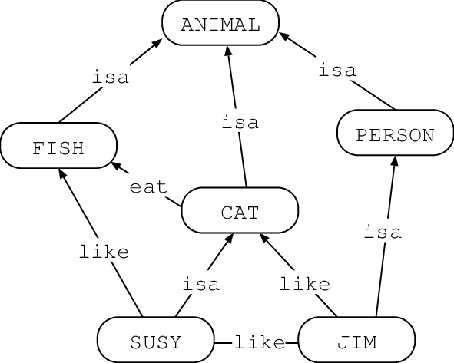
Sample Semantic Net

Slide 22
Advantages of Semantic Nets
Easy to understand
We can identify relationships
Easy categorization of knowledge
Nodes and objects are represented only once

Slide 23
Disadvantages of Semantic Nets
It has limited handling of quantifiers
Cannot express connectives
Difficult to represent some statements e.g how would we represent the statement “Khadija and Adannor really Caused trouble during the last school trip to Mombasa”

